Slide 1
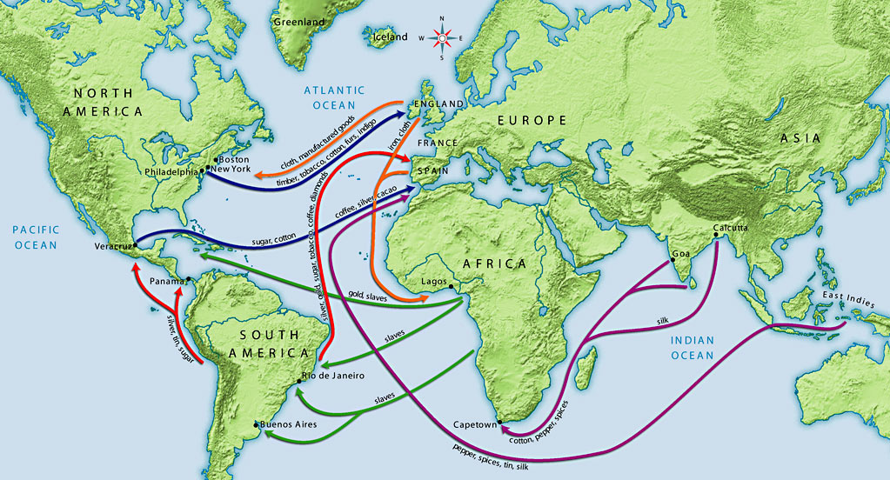
16th Century Trade Routes

Slide 2
Portuguese Exploration
In early 1498, Vasco de Gama sailed around the Cape of Good Hope at the southern tip of Africa entering the Indian Ocean
His fleet reached the port of Calicut on the western coast of India on May 18, 1498, and returned to Europe laden with spices
Arab fleets along the Indian coast threatened the new found trade route

Slide 3
Portuguese in India
Each year the Portuguese sought to eliminate the Arabs and establish a monopoly on the spice trade
In 1509, they defeat a combine Turkish and Indian fleet
Portuguese fleets blockaded the Red Sea to stop the flow of spices to the Arabs
In 1510, a Portuguese outpost was established at Goa

Slide 4
Portuguese in Asia
In 1511, a Portuguese fleet reached Malacca on the Malay Peninsula and captured the city
By 1535, Portuguese fleets had reached Macao in China
Within a few years the Portuguese had replaced Arabs as leaders in the spice trade
The spice trade earned enormous profits for the Portuguese

Slide 5
Portugal and Spain Challenged
By 1600, the Dutch, British and French began to threaten Spanish and Portuguese colonies
In 1602, the Dutch East India Company was established by the Dutch government
By 1650, the Dutch had gained control of Portuguese ports along the western coast of Africa
In 1652, Cape Town was established by the Dutch as a re-supply station for Dutch ships

Slide 6
Rise of the Dutch, British and French
By 1600, the Dutch had begun to replace the Portuguese in Africa and India
By 1600, the Dutch, British and French had reached India
By 1650, the British had forced the Dutch out of India
The British forced out the French in 1763 and gain complete control of India and its resources

Slide 7
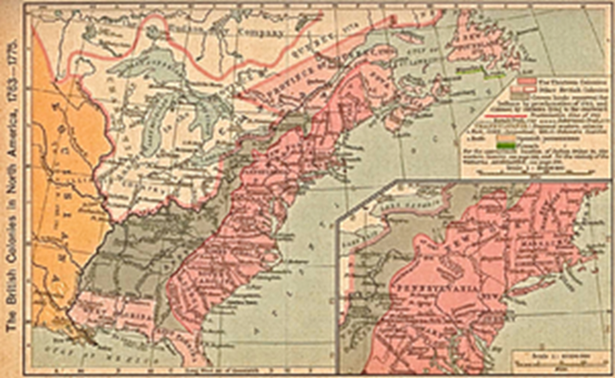
British in America
Established 13 colonies between 1607 and 1733
By 1674, had displaced the Dutch
Fought the French for control of America
By 1763, Britain became the dominant power in North America and India

Slide 8
The British Colonies
Virginia – 1607
Massachusetts – 1620
Maryland – 1632
Connecticut – 1636
Rhode Island – 1636
North Carolina – 1663
New York – 1664
Delaware – 1664
New Jersey – 1664
Pennsylvania – 1681
New Hampshire – 1691
South Carolina – 1729
Georgia - 1733

Slide 9
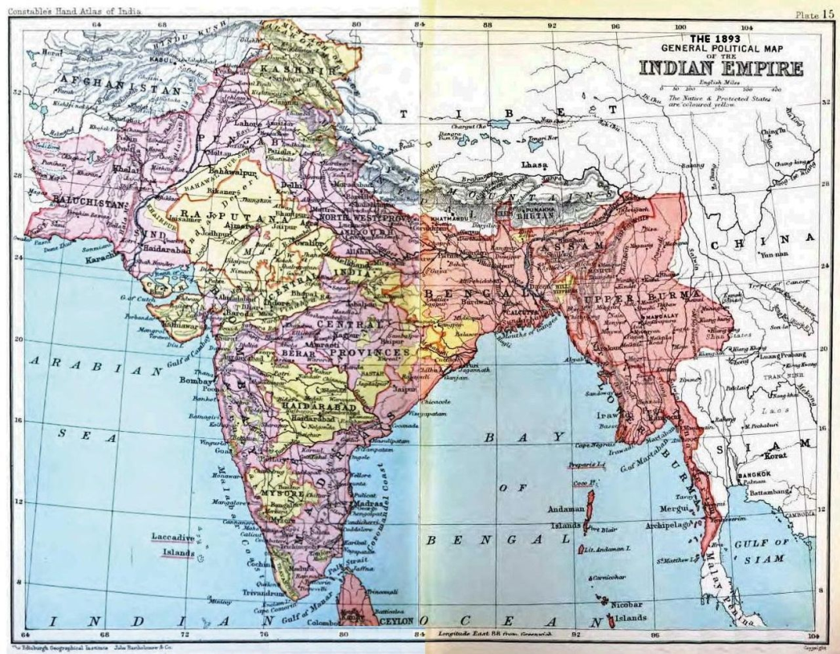
The British East India Company
Received a royal charter from Queen Elizabeth I in 1600
First fleet of 3 ships sent to India in 1601
By 1608, the company had established trading post on the west coast of India and Java
In competition with the Dutch East India Company

Slide 10
British East India Company
By 1700, had established major trading ports in India at Bombay, Calcutta and Madras
Made trade agreements with the ruler of the Mughal Empire
Traded Indian goods, such as pepper, tea, cinnamon, silk and cotton textiles to Europe and the American colonies
Replaced the declining Mughal Empire

Slide 11
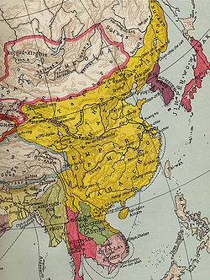
Europeans in China
By 1535, the Portuguese had arranged trade agreements with the Ming Dynasty
In 1644, the Ming Dynasty is replace by the Qing Dynasty
In 1699, the British established a trading post at Canton
British East India Company soon replaced the Portuguese as the leading traders in China

Slide 12
Europeans in Japan
By the 1540’s, the Portuguese had reached Japan, introducing trade and Jesuit missionaries
Portuguese introduce European technology, including weapons
In the early 1600’s, the Tokugawa ruler had expelled the missionaries and all European traders, except the Dutch

Slide 13
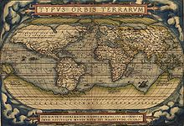
Europeans in the Americas
By 1600, the British, Dutch and French were seeking to establish colonies in the Americas
They controlled sugar, coffee, tobacco and cotton plantations throughout the Caribbean
As the plantations expanded more African slaves were needed

Slide 14
British, Dutch and French in North America
In 1614, the Dutch established a settlement at the mouth of the Hudson River called New Netherlands
In 1607, the British established a settlement called Jamestown along the coast of present-day Virginia
In 1620, another British colony is established at Plymouth, along the coast of present-day Massachusetts
In 1608, the French established a settlement called Quebec City along the Saint Lawrence River

Slide 15

Development of the New World
By 1674, the British had displaced the Dutch
France signed over its colonies to Britain at the end of the Seven Years War in 1763
Britain became the dominant power in North America and threatened Spanish and Portuguese colonies

